Slide 1

Automated Itinerary Planning
Project Progress Report
January-May 2018
By
Shaurya Purohit (159102119)
Shaurya Shikher (159102120)
Swapnil Rawat (159102138)
Saamarth Rastogi (159108111)
Information Technology
MANIPAL UNIVERSITY JAIPUR
JAIPUR-303007
RAJASTHAN, INDIA
May 2018

Slide 2
OUTLINE
Problem Introduction
Objective
Progress Chart
Methodology
Implementation and Results
Future Work and Conclusion
References

Slide 3
PROBLEM INTRODUCTION
Most of the people love to travel.
They visit popular tourist destinations such as monuments, natural parks, entertainment spots, etc. and plan a trip every once in a while to relax, explore new things or simply for shopping and quality time.
Creating this plan efficiently is not easy as the user has to first do a full research of the area he has to visit and then consider a lot of factors such as distance and visiting timings.

Slide 4
OBJECTIVE
The aim of the project is to design an itinerary that considers all the constraints such as time, cost as well as user’s preferred choices.
A high rated place may not be gorgeous for the users who have visited the city for several periods or have incomplete time economic understanding.
The user may instead want to go to a low rated place as it will be new for him.
That is why having a user preferred itinerary is more useful.

Slide 5
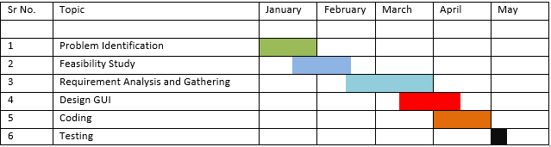
PROGRESS CHART Approximate time 5 months

Slide 6
METHODOLOGY
The methodology that has been used is iterative waterfall model.
First the problem was identified and checked whether it was feasible to implement. Then requirements were analyzed and gathered.
A user friendly webpage was designed for users where they can fill their choices and available slots. Considering various constraints an algorithm has been analyzed.
Use of language such as Python, HTML using CSS and scripts such as PHP and Javascript.

Slide 7
Working Algorithms Ant Colony Algorithm
The ant colony algorithm is an algorithm for finding optimal paths that is based on the behavior of ants searching for food.
At first, the ants wander randomly. When an ant finds a source of food, it walks back to the colony leaving "markers" (pheromones) that show the path has food. When other ants come across the markers, they are likely to follow the path with a certain probability. If they do, they then populate the path with their own markers as they bring the food back. As more ants find the path, it gets stronger until there are a couple streams of ants traveling to various food sources near the colony.
Because the ants drop pheromones every time they bring food, shorter paths are more likely to be stronger, hence optimizing the "solution." In the meantime, some ants are still randomly scouting for closer food sources. A similar approach can be used find near-optimal solution to the traveling salesman problem.
Once the food source is depleted, the route is no longer populated with pheromones and slowly decays.
Because the ant-colony works on a very dynamic system, the ant colony algorithm works very well in graphs with changing topologies. Examples of such systems include computer networks, and artificial intelligence simulations of workers.

Slide 8
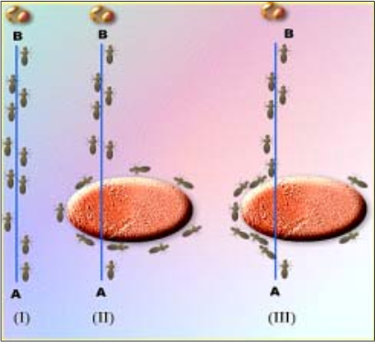
Observations made on Real Ants behavior

Slide 9
K-Nearest Neighbor Technique
The nearest neighbor algorithm was one of the first algorithms used to determine a solution to the travelling salesman problem.
In it, the salesman starts at a random city and repeatedly visits the nearest city until all have been visited. It quickly yields a short tour, but usually not the optimal one.
During lunchtime, using the user’s current location, nearby restaurants will be suggested and after lunchtime Ant Colony Optimization will be continued

Slide 10
USE CASE

Slide 11
ENTITY RELATIONSHIP DIAGRAM

Slide 12
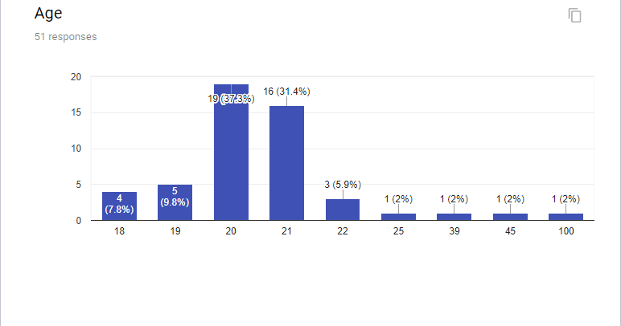

Slide 13
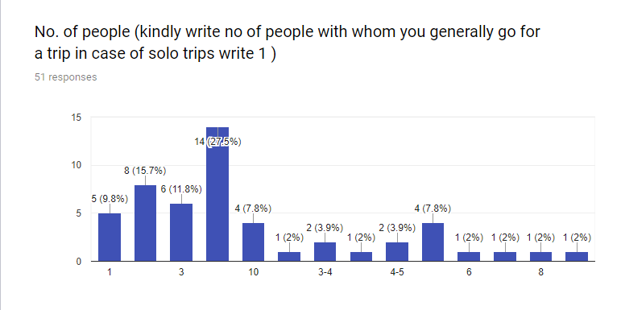

Slide 14
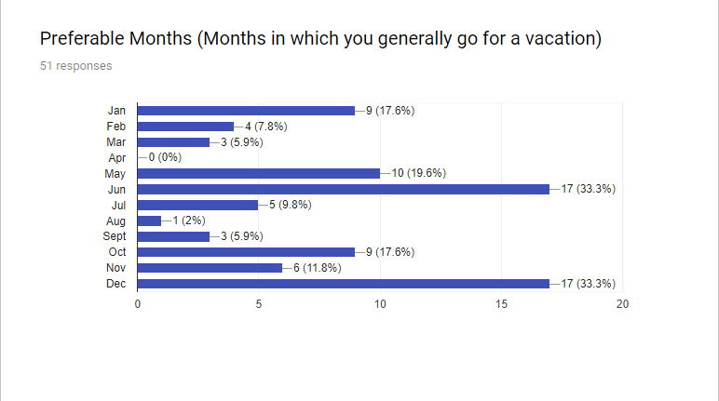

Slide 15
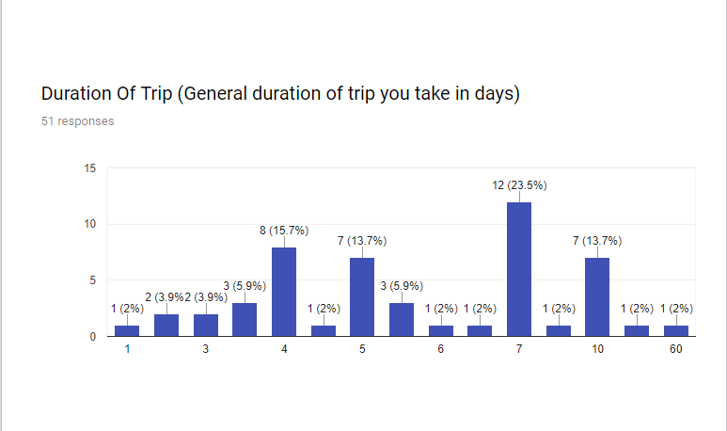

Slide 16
EXCEL DATA( Data collected in form of survey)

Slide 17
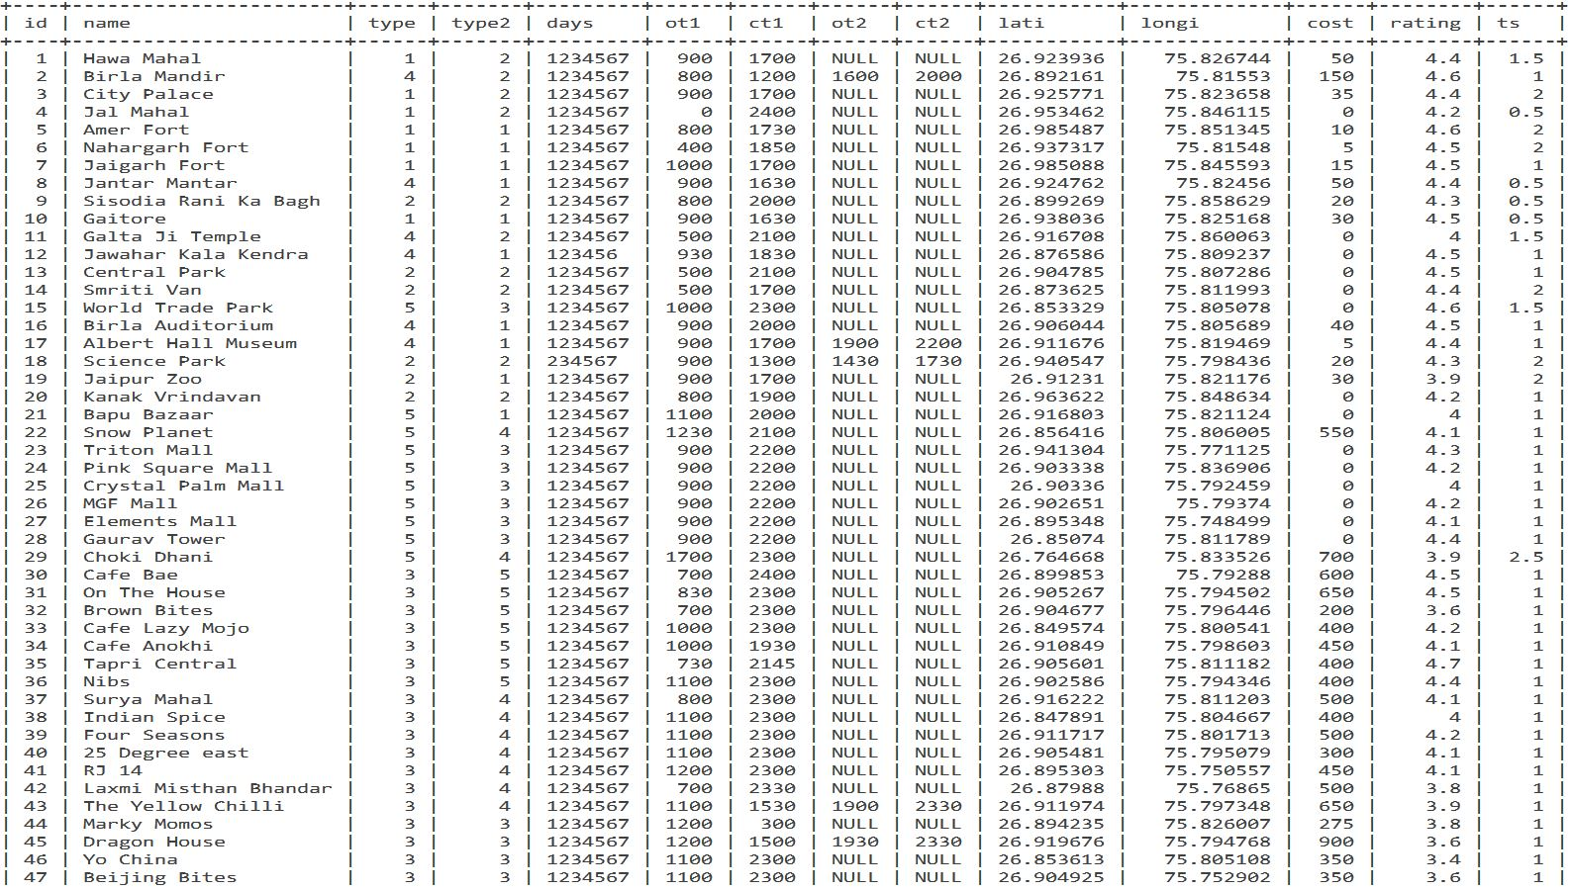
Tourist Destinations in Jaipur

Slide 18
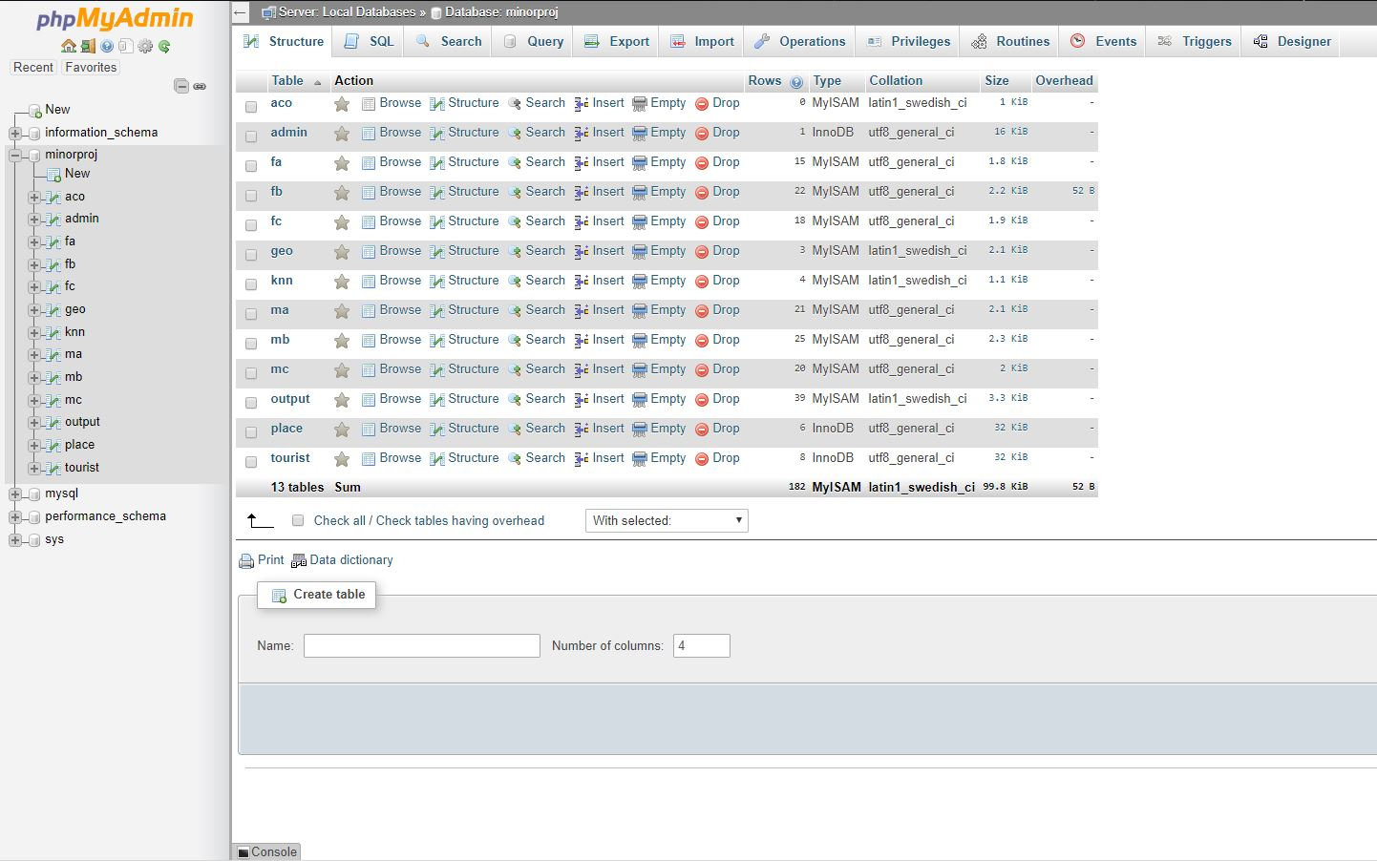

Slide 19
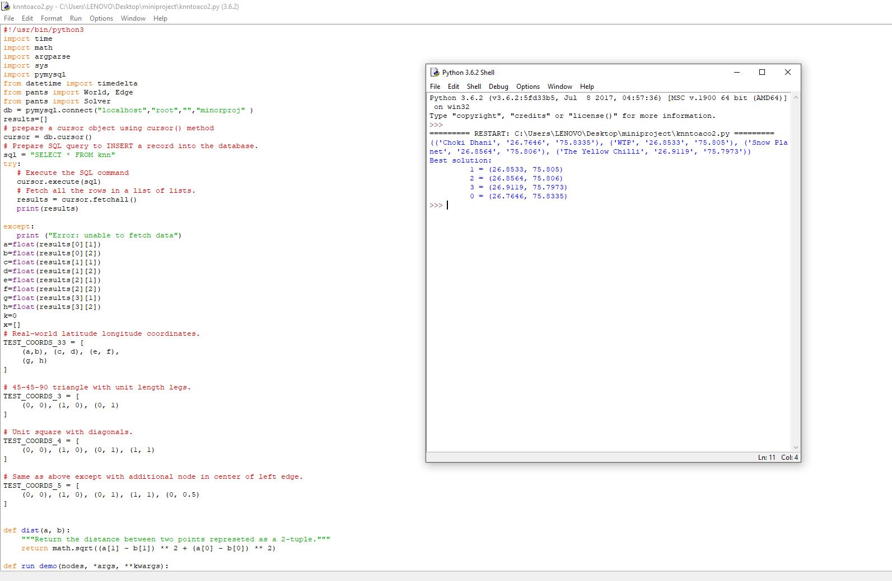
RESULTS
Ant Colony Optimization

Slide 20
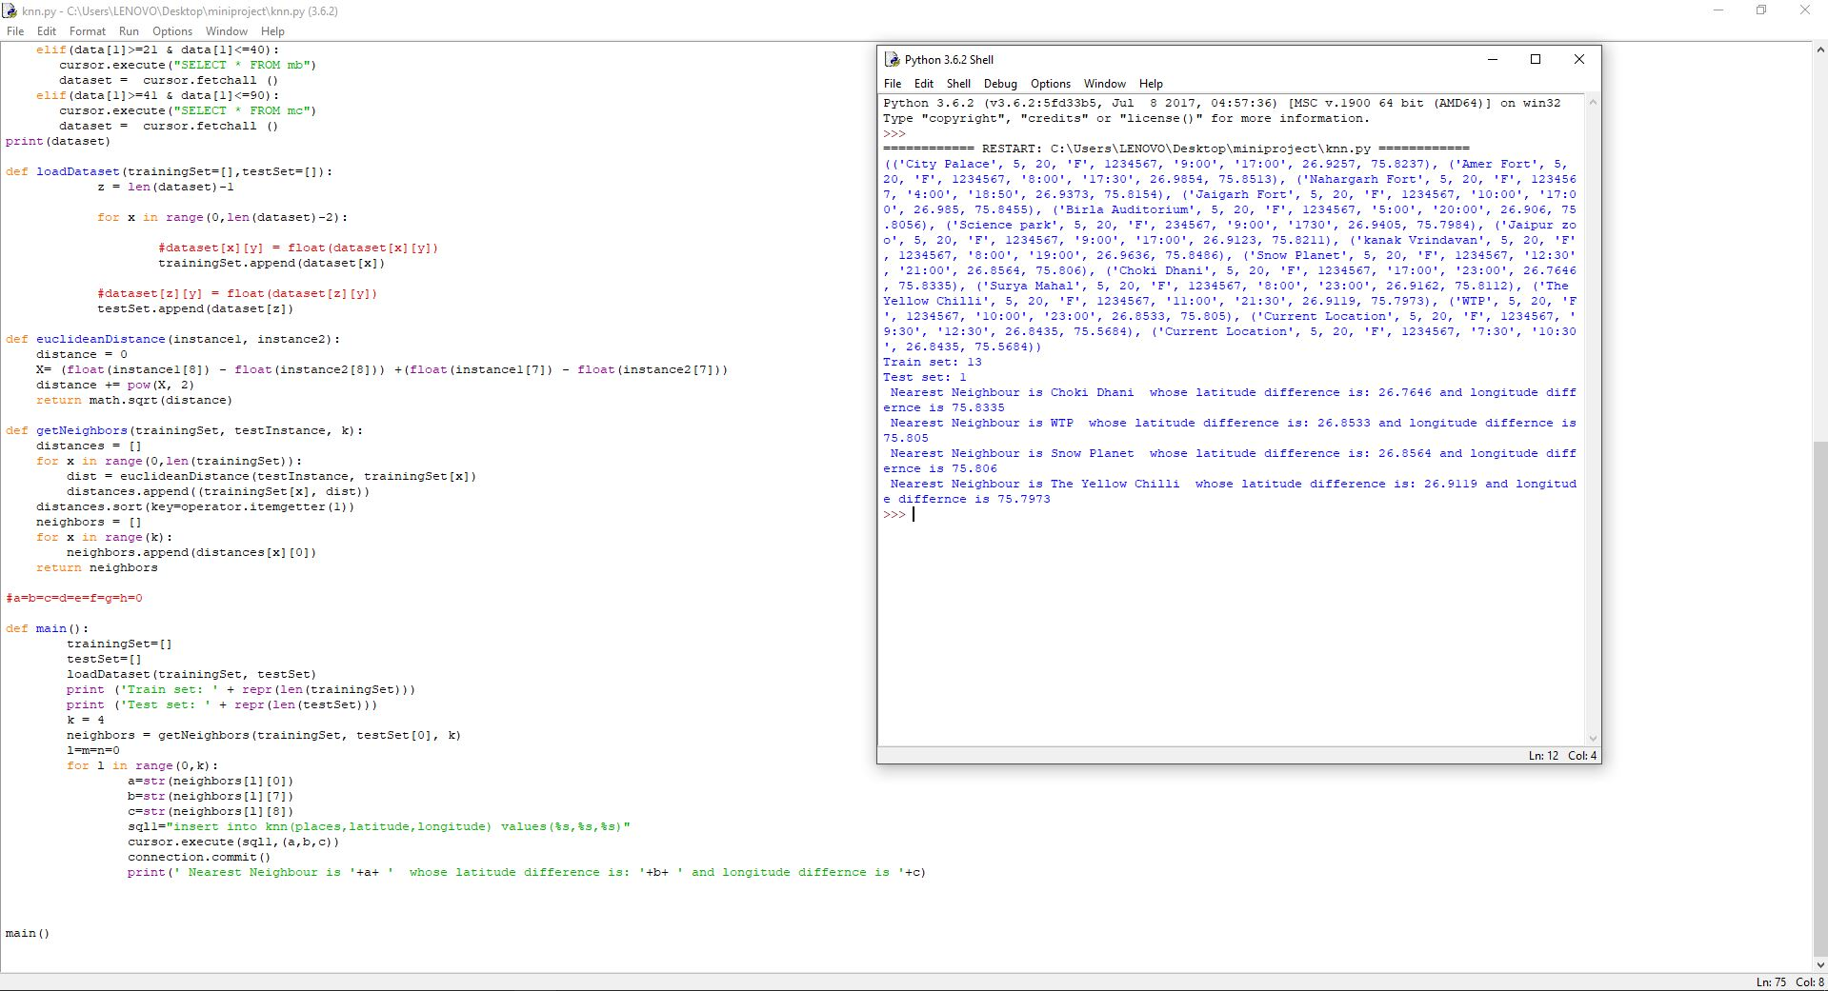
K-Nearest Neighbor

Slide 21
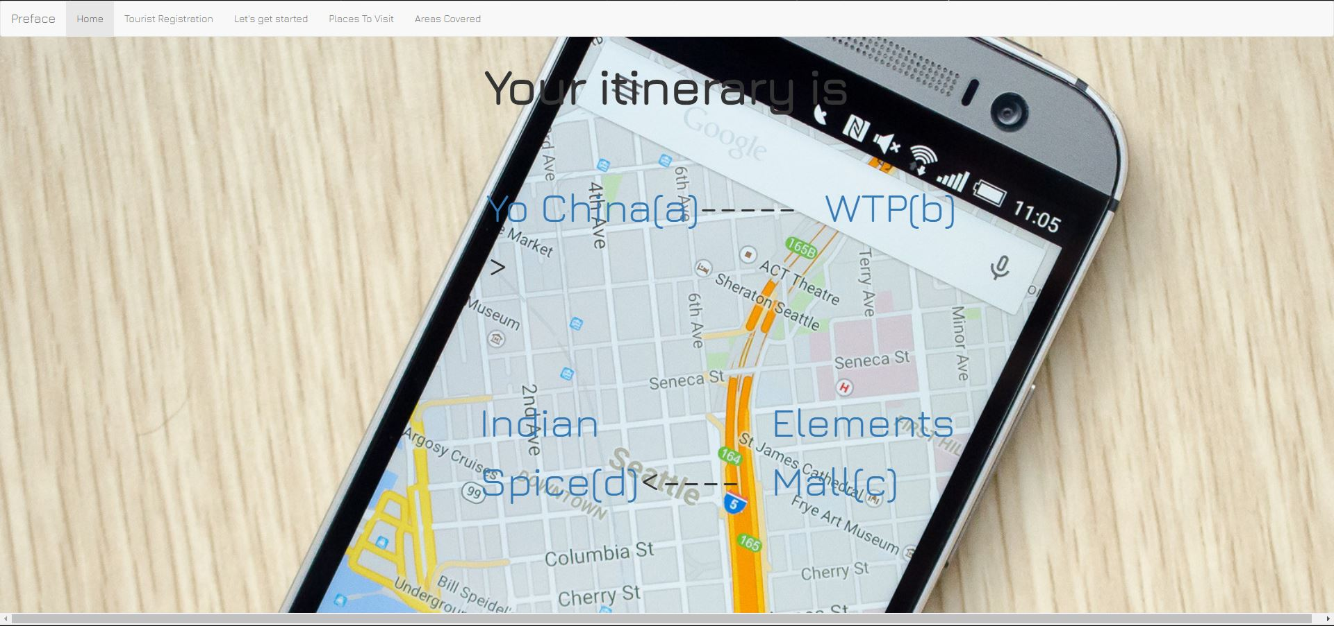

Slide 22
Future Work
Some places are mostly preferred by people to visit in the evening such as Birla Mandir and thus a person would most probably like to visit Birla Mandir in evening. But the itinerary generation has not been done considering this factor because of insufficient data available regarding the same. Thus popular visiting hours of places can be collected and thus factored while designing the itinerary.
This project only covers one city Jaipur. It can be extended to more cities and further to an entire country.
The itinerary can be dynamic. Suppose after an itinerary is created and user starts travelling as per the created plan. But after reaching a specific location defined in the itinerary, the user spends more than the average time spent at that place. Then he will specify the time at which he left that destination and then the rest of the itinerary will be changed accordingly
To have better outreach and proper implementation partnership with some of the transport aggregator like Ola , Uber can be boon for this service as they have very large dataset and extend services which are used by tourists on large scale also it would help in creating revenue which is not possible otherwise in such a large scale .

Slide 23
CONCLUSION
The project designs an itinerary containing a list of places to be visited at given timings.
This itinerary is designed using ant colony optimization and KNN algorithm which takes into account
The time slots in which user is available
The distance between various places
The opening and closing timings of tourist spots and ratings of different destinations.
It is difficult for a person to consider all these factors simultaneously for a comfortable trip. This project makes the job easier and faster so that the user can enjoy his trip.

Slide 24
REFERENCES
S.B. Roy, G. Das, S. Amer-Yahia, and C. Yu, “Interactive Itinerary Planning,” Proc. IEEE 27th
Int’l Conf. Data Eng. (ICDE), pp. 15-26, 2011.
Kwan Hui Lim, “Recommending and Planning Trip Itineraries for Individual Travellers and
Groups of Tourists”, Department of Computing and Information Systems, The University of
Melbourne, Australia, 2016
Popular tourist spots in Jaipur, tripadvisor, “https://www.tripadvisor.in/”
Jaipur tourism, Ixigo, “https://www.ixigo.com/”
Google Maps APIs, “https://developers.google.com/maps/”
Bootstrap, “http://getbootstrap.com/”
Ant Colony Optimisation, ” https://en.wikipedia.org/wiki/Ant_colony_optimization_algorithms”
Itinerary Planner, inspirock, “https://www.inspirock.com/”
Python, https://en.wikipedia.org/wiki/Python_(programming_language)
Ping Duan, Yong AI , “Research on an Improved Ant Colony Optimization Algorithm and its Application”, pp. 223-234
Yun-lei Cai, Duo Ji ,Dong-feng Cai, “A KNN Research Paper Classification Method Based on Shared Nearest Neighbor”, 2012

